Slide 1
Empirical and Molecular Formulas
Share one copy of this with your group.
Make your own copy at the end of the lesson.

Slide 2
Recall: Breaking Down Compounds into Elements
Each person in the group should work on one of the following compounds:
H₂O CH₄ Ca₃(PO₄)₂
Guiding Questions:
1. How many atoms of each element are in your compound?
2. What is the molar mass of each element in your compound? (Use the periodic table.)
3. How do you calculate the total molar mass of the compound?
If unsure of your answers, check with another group &/or instructor.

Slide 3
ESSENTIAL QUESTIONS
How can we determine what fraction of a compound’s mass comes from each of its elements?
Why is knowing the percentage composition of a compound useful in real-world applications?
How does percentage composition help us predict the simplest (empirical) formula of a compound?
Remember, you should be able to thoroughly answer these AFTER learning through following resources.

Slide 4
Instructions
Follow through the Engage to Apply resources in order .
Once confident, attempt Taking it Further work if available. This is Level 4 for course.
Record your learning in these slides. Remember to keep track of where to find these slides for studying!
Submit work from the Apply Section, IF INDICATED. Otherwise, it is regular practice work.
Try the Extend section as desired to deepen your understanding

Slide 5
Links To sections
Click for quick access to:
Engage
Explore
Apply
Extend

Slide 6
Part 1: ENGAGE (5 minutes)

Slide 7
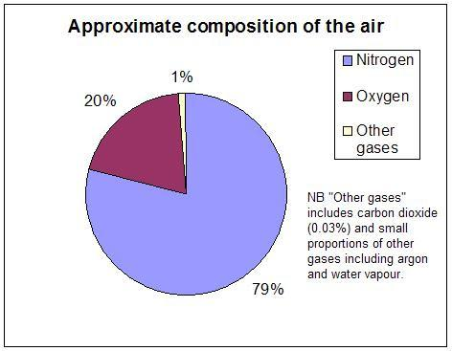
Engage: Using percents!
In your group, answer the following:
What does percent mean?
Using the pie graph, if you had 100L of air , how much would be nitrogen?
If you had 50L of air, how much would be oxygen?
If you had 34.6L of air, what equation could you set up to solve for the among of nitrogen?

Slide 8
Engage: Scenarios
Discuss how knowing the percentage composition of a substance would be important in at least 2 of the following:
Pharmaceuticals/Medicines
Crime Scene situations
Chemical spills
Agricultural fertilizers
Water pollution science

Slide 9
Part 2: EXPLORE (20 - 30 minutes)

Slide 10
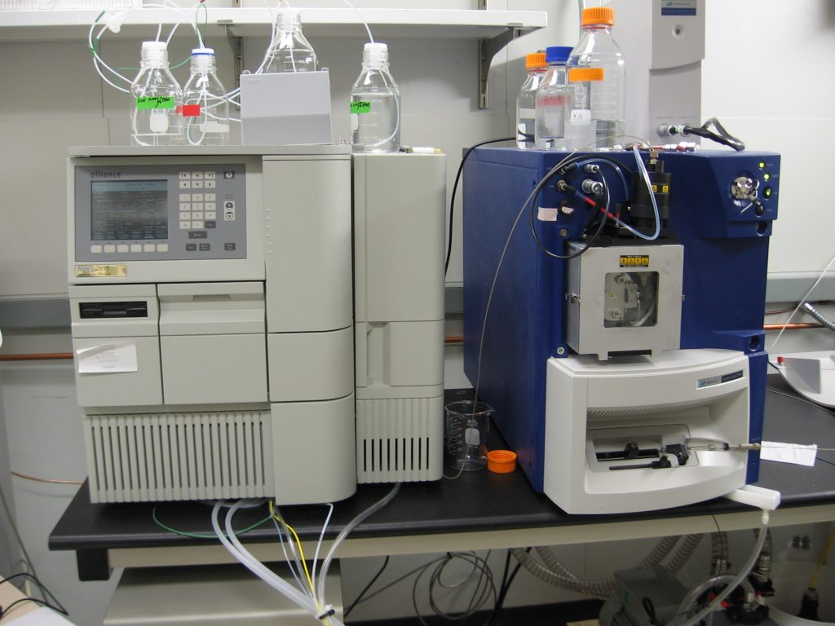
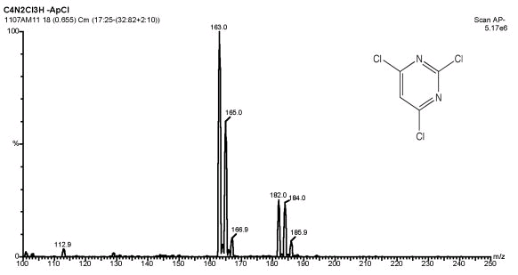
Explore: How we determine composition
RECALL: Law of Constant Composition means compounds contain elements in fixed proportions that are Always the SAME for the same compound!
Equipment for determining the formula (proportions):
Mass Spectrometer (as seen on CSI shows): can determine the molar mass of many compounds by vapourizing a small sample, ionizing it (giving it a charge) and deflecting the charged gas in a magnetic field. The amount of deflection gives the mass.
Combustion Analyzer: Determines amount of C, H, O and N by burning the substance in pure oxygen and analyzing the products.
** Be able to recognize these two methods for multiple choice questions.

Slide 11
Explore: Definitions to Know
Empirical Formula
Gives the lowest ratio of atoms in a compound, but may not tell the exact number of each type of atom
Molecular Formula
Indicates the actual numbers of atoms in one molecule of a compound

Slide 12
Explore: What is the matching empirical formula?
 | Molecular | Empirical
Hydrogen peroxide | H₂0₂ | Fill in!
Sugar | C₆H₁₂O₆ | Fill in!
Check your work on the next slide.

Slide 13
Explore: Check your understanding!
 | Molecular | Empirical
Hydrogen peroxide | H₂0₂ | HO
Sugar | C₆H₁₂O₆ | CH₂O

Slide 14
Explore: A good problem solving strategy!
If you aren’t already, please USE GRASP in Chemistry:
Given: List all information with units given in problem.
Required: Include what you need to determine in your data list
Analysis: List formulas first, then enter given data
Solution: solve for Required. There may be more than one. Remember UNITS.
Paraphrase: A therefore statement indicating your understanding of the solution.

Slide 15
Explore: Percentage Composition
The next few slides will ask you to think through calculating the percentage composition of compounds. First, from mass data such as that generated by mass spectrometers. Then from atomic mass of the elements in a compounds.
REMEMBER: Percent is just percent! How much of one element out of the total mass of the compound?
Show your work!

Slide 16
Explore: Try this!
Complete next several slides on a class whiteboard and insert photos of your work (or other record) on each slide.
Solve by working through next several slides: A 13.5g sample of a compound is determined to have 7.46g of strontium and 6.04 of chlorine. Determine the % composition of each element.

Slide 17
Explore: Problem 1 - Calculate the % composition of carbon dioxide, CO₂ from atomic mass.
Step 1 : Calculate total atomic mass of each element in the compound.
m_{c} =
m_{o} =

Slide 18
Explore: Problem 1
Show your calculation of the molecular mass of CO₂.
Molecular mass_{CO2}=
Ans: 44.01amu (or just u for units)

Slide 19
Explore: Problem 1 - Now determine % composition by mass of oxygen in CO2. Then do % of carbon. {Use GRASP}
Therefore statement:

Slide 20
Explore: Problem 2 - Empirical formulas from Mass Data
A compound contains the following % compositions:
C = 38.71%
H = 9.71 %
O = 51.58%
Determine the mole ratio of the elements. Use the mole ratio to determine the Empirical Formula.
HINT: If you have a 100g sample, how many grams will be carbon? If you know the grams, what quantity can you convert to? Check the next blue solution slide to get started after trying!

Slide 21
Solution:
100g sample
C = 38.71% → 38.71g
H = 9.71 % → 9.71g
O = 51.58% → 51.58g
Convert each to moles
n = m/MM
n_{c} = 38.71g/12gmol⁻¹
= 3.22 mol
n_{H} = 9.71g/1.01gmol⁻¹
= 9.61
n_{O} = 51.58g/16.00gmol⁻¹
= 3.22
You aren’t at a chemical formula yet, but you do have mole ratios.
Discuss as a group how you could use them to determine the empirical formula (lowest whole number ratio), then continue to the next slides for some guidance!

Slide 22
Explore: Problem 2 - Empirical formulas from Mass Data
You now have a molar ratio of the elements:
C : H : O
3.22: 9.61 : 3.22
Numbers in compound formulas are always whole numbers though. What can you do to get whole numbers? Think before going to next slide!

Slide 23
Solution
C: H : O
3.22: 9.61 : 3.22
Divide by smallest # to get to whole number ratio. Round the 2.98 to 3. Recall this was experimental data so it won’t give perfect results. 2.98 is very close to 3 within experimental error!
Final empirical formula: CH₃O

Slide 24

Explore: Problem 3 - Determine molecular formula given the molecular mass of the compound.
Reminder: Empirical formula is CH₃O. Recall the difference between empirical and molecular formulas!
Solve: If the molecular mass is 93.12 g/mol, what is the molecular formula?
Discuss how you could use this information together with the empirical formula and try to solve. Check in with your instructor to see if you are correct!

Slide 25
Explore: Problem 4 - Determine the formula, using the same process, for a compound containing 69.9% Fe and 30.1% O.

Slide 26
Explore: Problem 4 - If you found a ratio of 1: 1.5 for Fe:O (this is a correct step towards the final answer):
Since 1.5 atoms of oxygen isn’t possible, how can this ratio be maintained in the final empirical formula without having 0.5 of an atom? Show your work!

Slide 27
Part 3: Apply
(20-40 minutes; includes home practice time)

Slide 28
Apply: Check your understanding
1. A compound is 27.5% carbon and 72.5.0% oxygen by mass. What is its empirical formula?
a) CO
b) CO₂
c) C₂O
d) C₃O₂
Room to show your work:
Answer: move box to check
b) CO₂ ✅ (Solution: 27.5g C ÷ 12.01 ≈ 2.29 mol; 60g O ÷ 16.00 ≈ 4.53 mol → ratio 1:1.98 ≈ 1:2 ratio of C:O. Therefore, CO₂)

Slide 29
Apply: Check your understanding
2. If 100g of sucrose (C₁₂H₂₂O₁₁) is analyzed, how many grams of hydrogen are present?
a) 1.2g
b) 22.0g
c) 13.0g
d) 6.5g
Room to show your work:
Answer: move box to check
d) 6.5g ✅ (Solution: %H = (22 × 1.01) ÷ 342.3 × 100 ≈ 6.5%. Therefore, 6.5g in 100g)

Slide 30
Apply: Check your understanding
3. A student gets an empirical formula of CH_{1.32}. How can they fix this?
Group answer:
4. Why do C6H12O6 (glucose) and C3H4O (cyclopropanone) behave differently despite having the same elements?
Group answer:
Answer: move box to check
3. Multiply by 3 to get whole numbers: C₃H₄
4. Different ratios of H and O change molecular structure, affecting properties like solubility and reactivity.

Slide 31
Apply: Real world
Why is percentage composition used in forensic chemistry?
a) To measure a compound’s density
b) To identify substances by comparing elemental ratios
c) To determine the color of a powder
d) To calculate the boiling point of liquids
Answer:
b) this can help identify the substance & solve the case!

Slide 32
Apply: Practice Work
Complete the practice work as indicated in the unit plan and/or sheets given in class.
If time allows you can ask for and play “Kitchen or Crime Scene”
Remember! Its important in this unit to do plenty of practice to be confident of each topic before moving to the next one! It is also good practice to save some practice work, once you are confident, to complete over the next several days & weeks from the lesson.
Spaced practice solidifies your understanding and long term retention!

Slide 33
Part 5: Beyond the course extensions & Extra help {optional}

Slide 34
Extend: Read this article. On the spot crime scene analysis!
MIT develops handheld mass spectrometer.

